Slide 1

Predicting Fantasy Football Lineups
Jared Booth

Slide 2
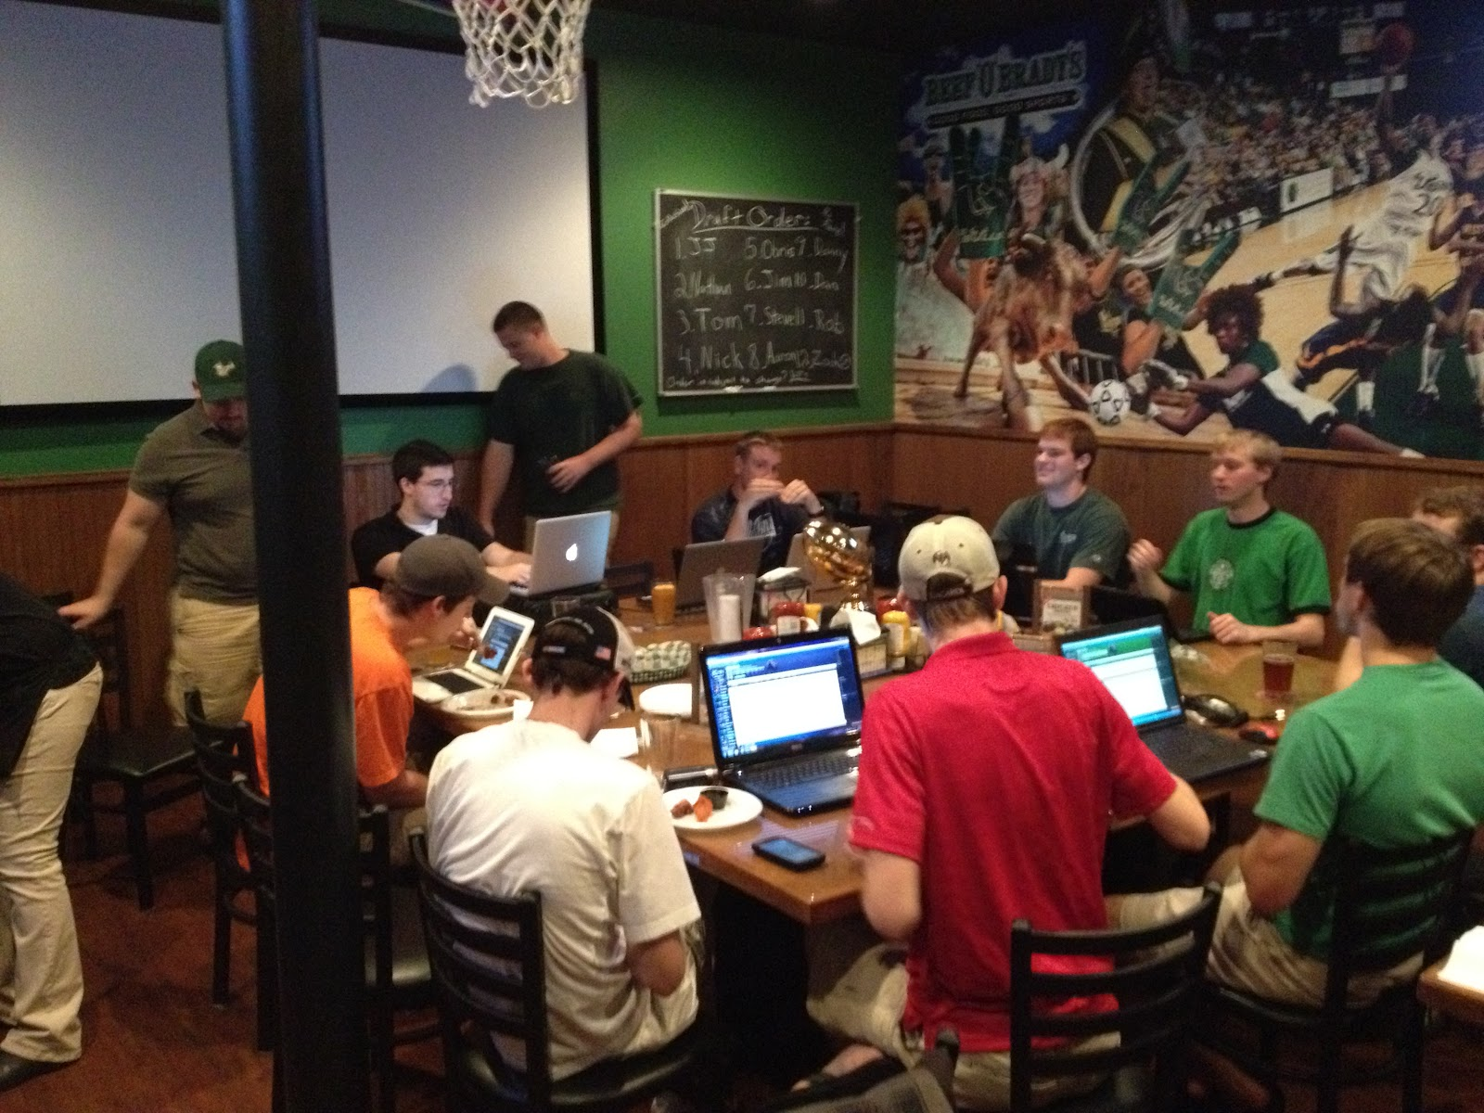
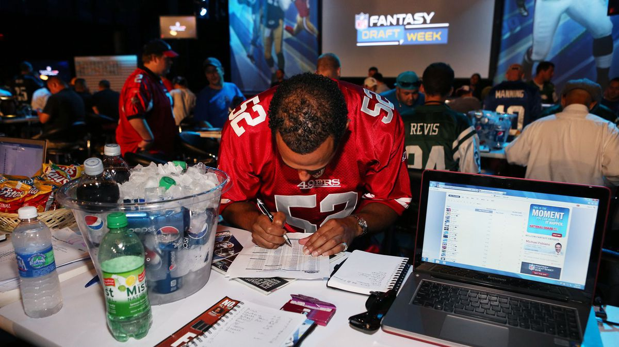
What is Fantasy Football?
DRAFT
WEEKLY

Slide 3
Growth of fantasy sports
Fantasy sports are now attributed to a roughly 7 Billion dollar economic impact.

Slide 4
Example Line-up

Slide 5
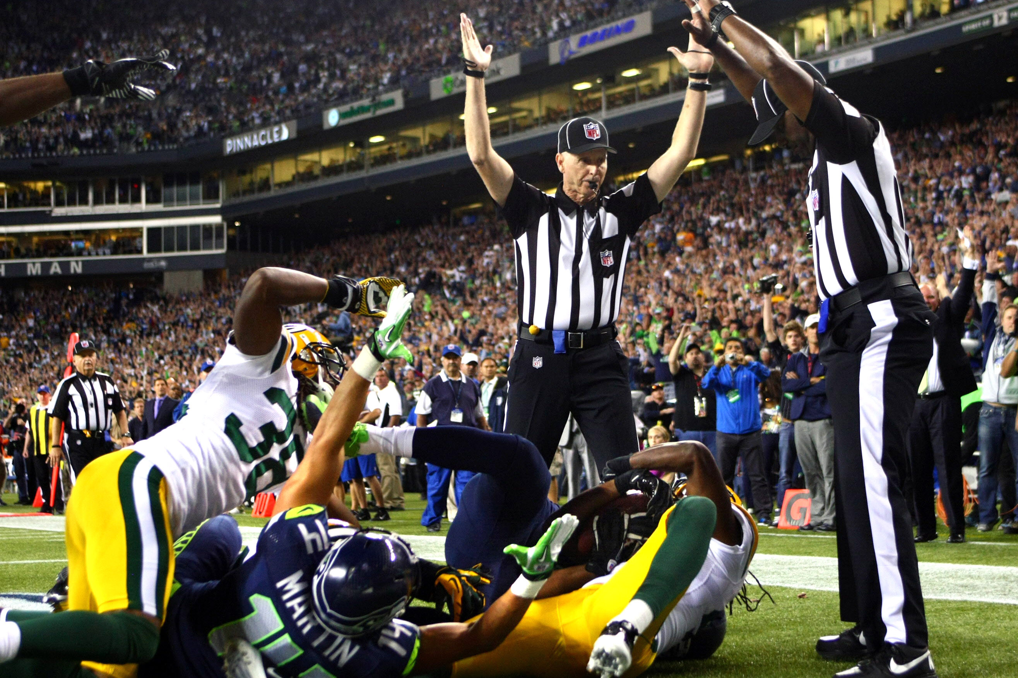
Goal
Create a model that will predict which players will earn the most points each week

Slide 6
Data
Scraped the data from multiple sources using BeautifulSoup
Pro-football-reference.com
fftoday.com
Included features that are known prior to the beginning of a game

Slide 7
Method
Future performance dependent on past performance
Created a deep learing model in keras called an LSTM which can be used for time series data

Slide 8
Model
I trained the models on three years of data leading up to the 2017 season
I then tested each week of the 2017 season and added each past week back into the training set
Test
Train

Slide 9
Results

Slide 10
Results
Predicted player | points | Best player | points
QB: Russell Wilson | 30.92 | QB: Russell Wilson | 30.92
RB: LeSean McCoy | 24.6 | RB: LeSean McCoy | 24.6
RB: Mark Ingram | 21.5 | RB: Latavius Murray | 21.6
WR: Antonio Brown | 32.4 | WR: Antonio Brown | 32.4
WR: Brandin Cooks | 20.9 | WR: Keenan Allen | 28.2
TE: Jimmy Graham | 13.8 | TE: Jimmy Graham | 13.8
FLEX: Jordan Howard | 18.5 | FLEX: Mark Ingram | 21.5
Total | 162.62 | Total | 173.02

Slide 11
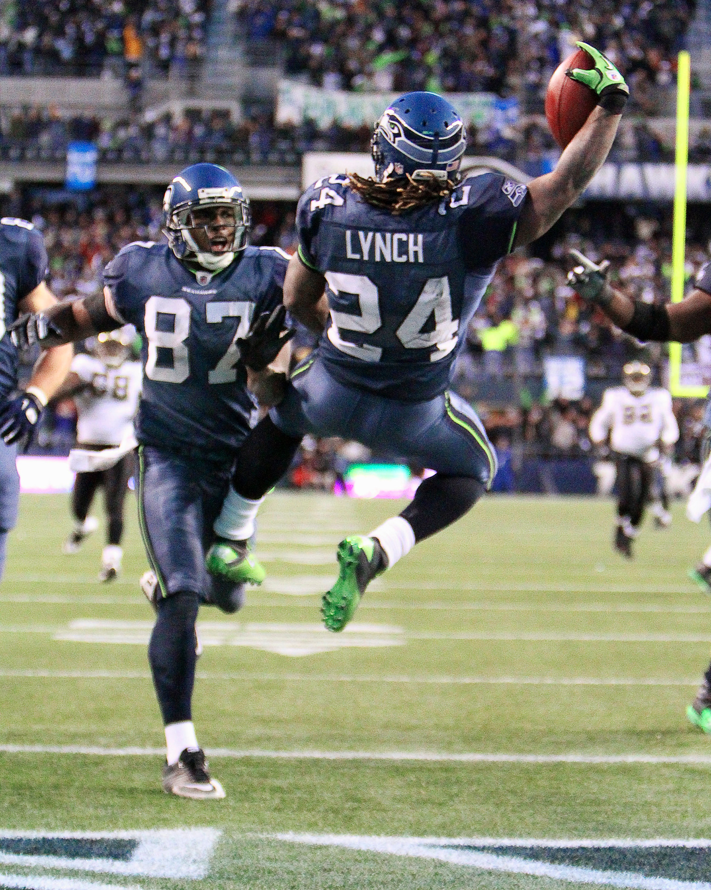
Conclusion
Many weekly football leagues allow for multiple entries and this model will excel in those leagues

Slide 12
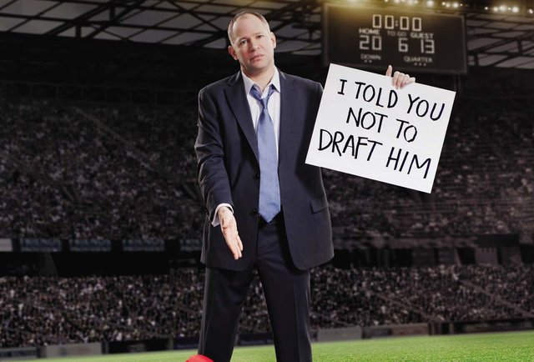
Next steps
Get point projection data*
This data will need to be scraped during the season on a per week basis for use in a future model

Slide 13
THANK YOU
Email: jzbooth@comcast.net
Blog: jzbooth.github.io/Booth_Metis/
Link’d in

